Slide 1
Project
Social Information Systems

Slide 2
Team Members
1-Dolagy Baky Farhid
2-Rania Kamel Habashy
3-Ishak Saad Awad
4-Andrew Haliem Metry

Slide 3
Project
Degree Distribution
Degree sequence
Adjacency Matrix
Simulation
Community Detection

Slide 4
Draw Graph

Slide 5
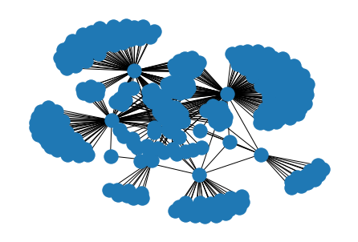

Slide 6
Adjacency Matrix

Slide 7
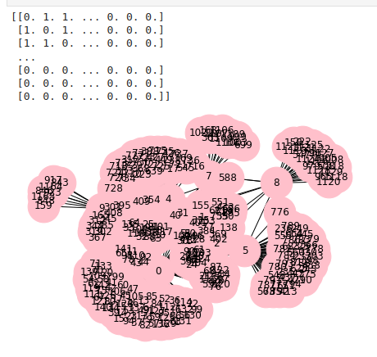

Slide 8
Degree sequence

Slide 9
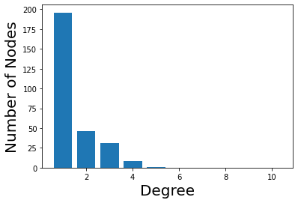

Slide 10
Degree Distribution

Slide 11
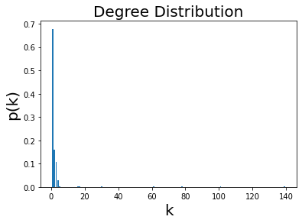

Slide 12
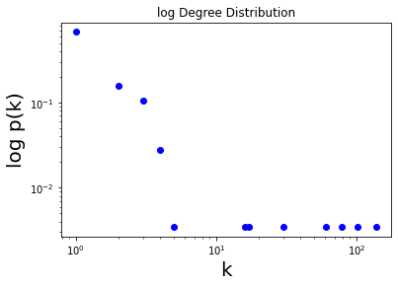

Slide 13
Simulation

Slide 14
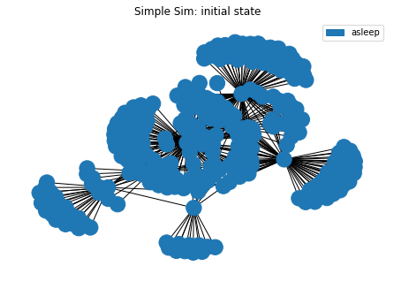

Slide 15
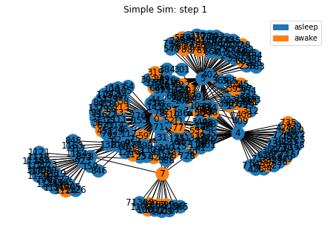

Slide 16
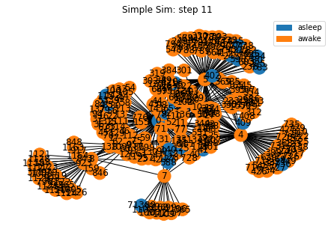

Slide 17
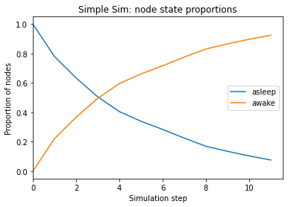

Slide 18
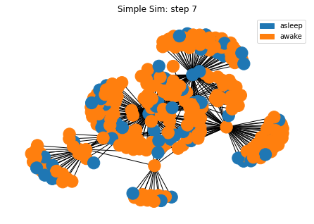

Slide 19
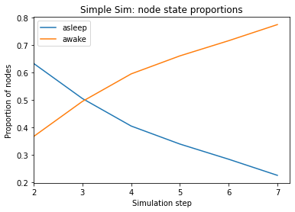

Slide 20
Community Detection

Slide 21
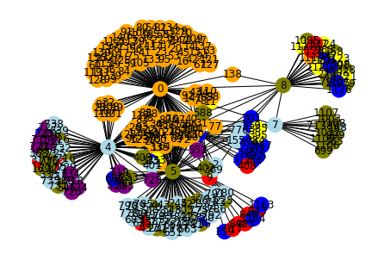

Slide 22
THANKS

